Slide 1
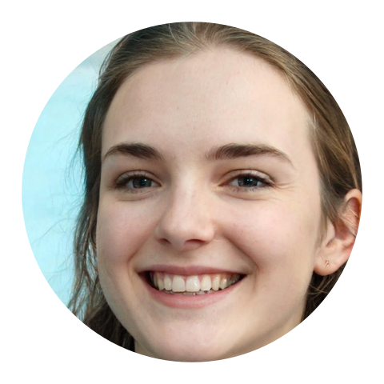
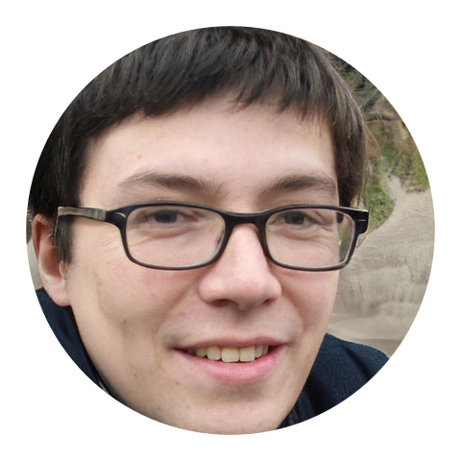
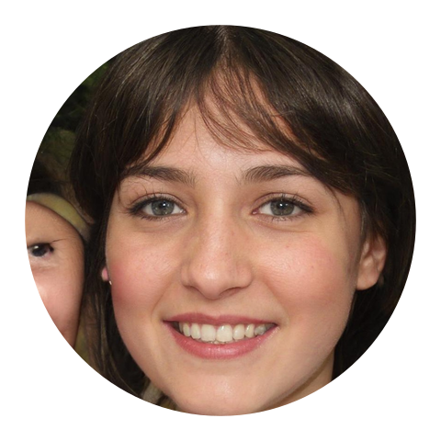

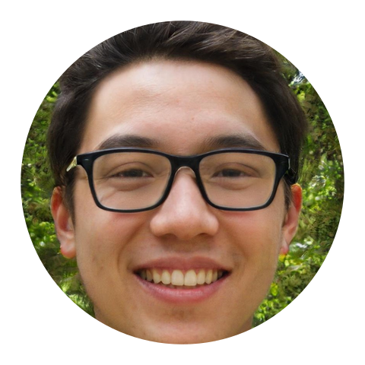
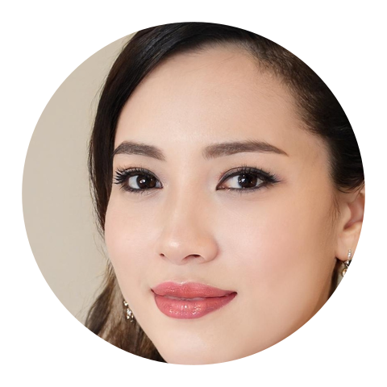
Overlap
Meet the people you already
share a campus with.
Web Programming · class presentation
Rahimjon 202438377
Asilbek 202438394
Shuhratxon 202537358
Portraits are AI-generated. Nobody shown is a real student.
Notes:
[0:00-0:40] Hi everyone, we are Rahimjon, Asilbek and Shuhratxon. We built Overlap, a web app for university students. The idea fits in one sentence: it introduces you to people on your own campus based on what you already share, such as the same course, the same club, or free time at the same hour. Everything you see today is a real, working app running on my laptop. The students in it are fictional: their names, their profiles and even their faces are invented, and the faces were generated by an AI, so nobody on screen is a real person. I will show you short screen recordings of the real app, then explain how it picks people, how it is built, and how I handle safety and privacy.

Slide 2
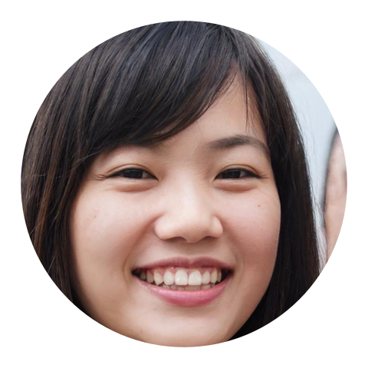
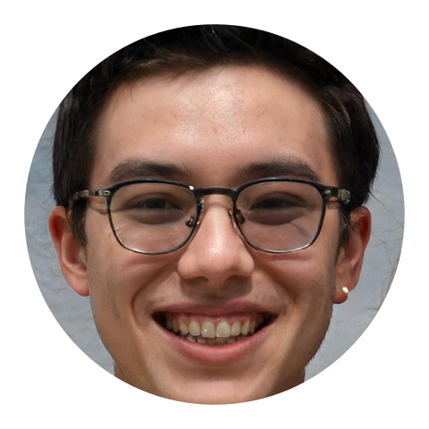

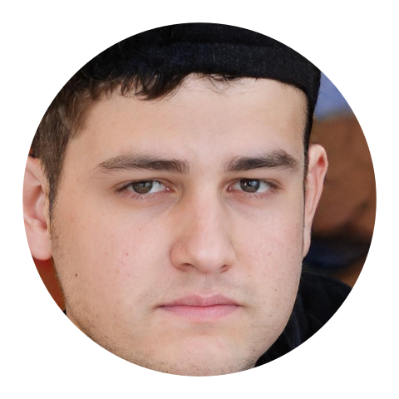
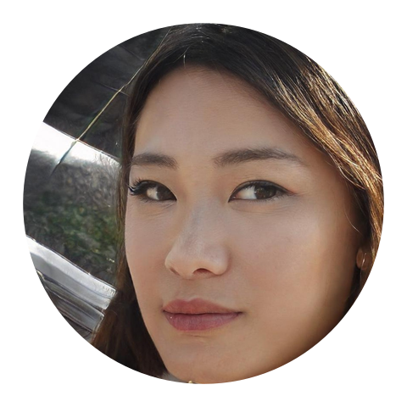
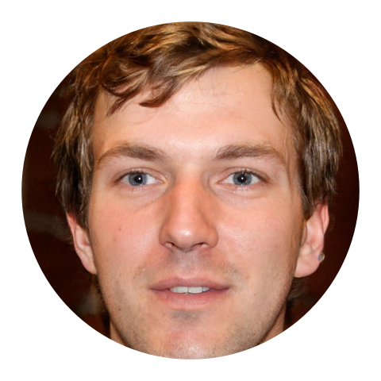

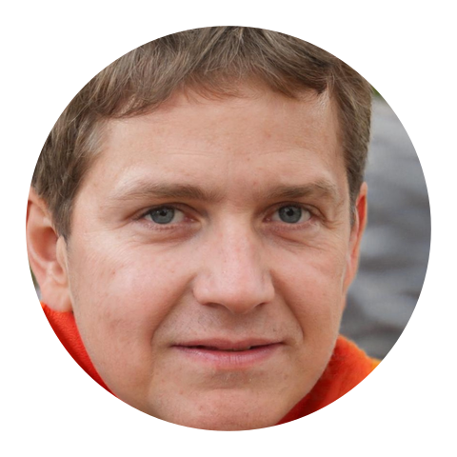
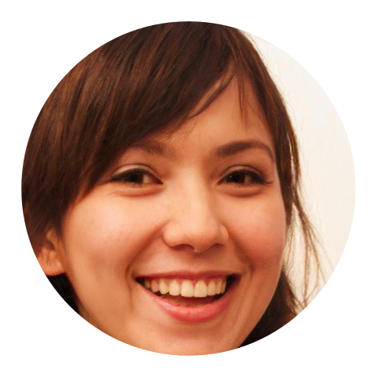
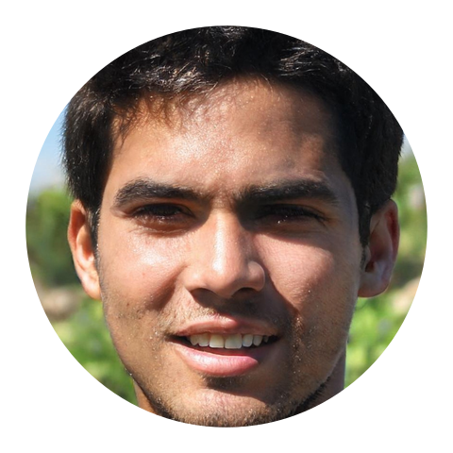
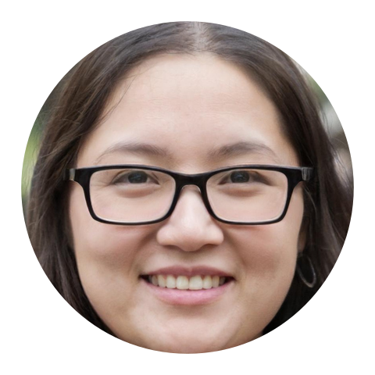
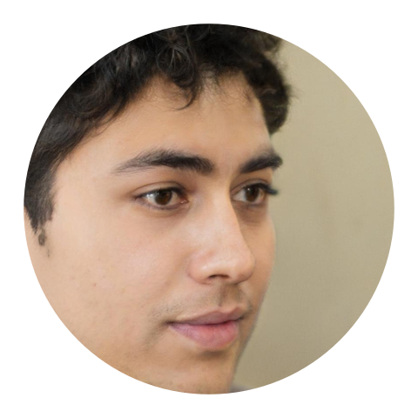
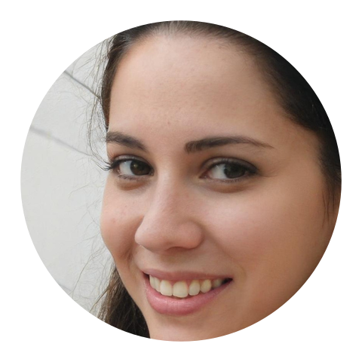
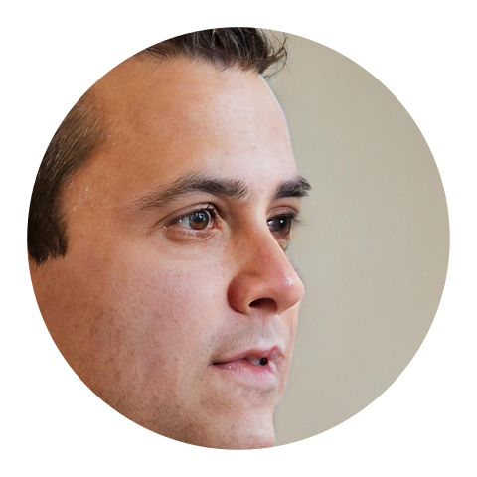
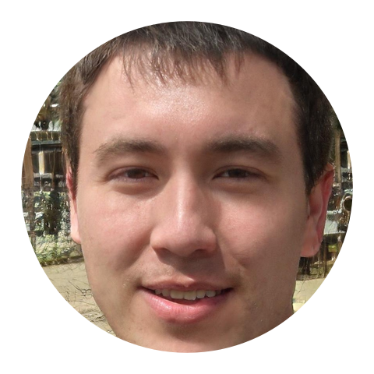
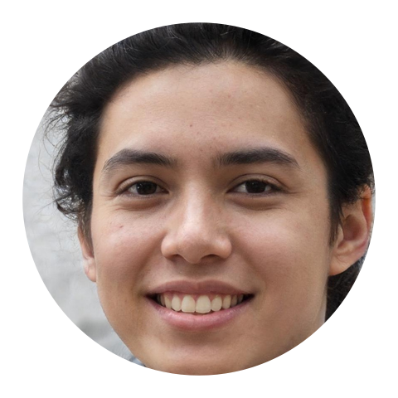
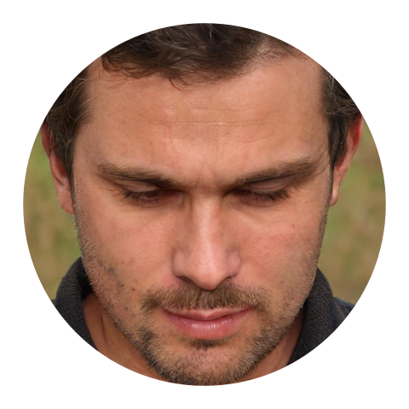
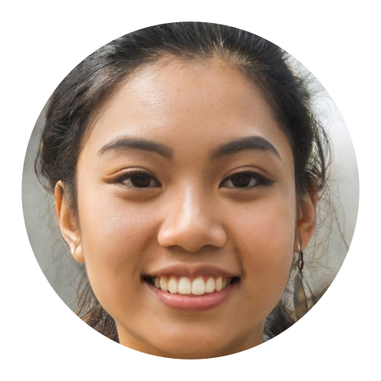
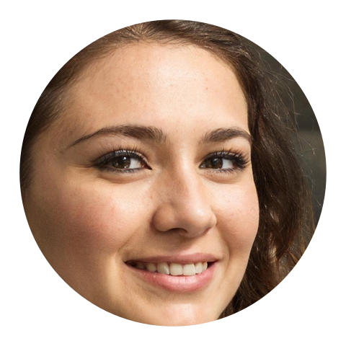
You share a campus with thousands of people and meet a handful
1
Same lecture, never spoken
You can see the same faces for a whole semester without ever saying hello.
2
Most apps start from looks
A photo and a swipe tell you nothing about whether you would actually get along.
3
Campus life has better reasons
A course, a club, a free hour: shared things make the first message easy.
IN PLAIN WORDS
Overlap introduces you to people through what you already share, so the first message has something to talk about.
Same course · same club · free the same hour
Notes:
[0:40-2:00] Think about your own lectures. You sit in the same room as a hundred people for a whole semester, and you might talk to two of them. Meanwhile most apps that connect people start from a photo and a swipe. But on a campus, you already have much better reasons to talk to someone: you take the same course, you are in the same club, you are both free on Monday afternoon. Overlap starts from those reasons. In this picture, each circle is a student. Two of them have a lot in common, and they have never spoken. That gap is what the app tries to close.

Slide 3
The idea: introduce people through what they share
1
Only shared things count
Courses, clubs, free time, interests and values make the score. Never looks.
Same course
2
Six people a day
Same club
A short list instead of an endless feed.
You
Someone new
Free same time
3
Every card explains itself
Shared interest
"You're both in Data Structures" tells you exactly why you were introduced.
What you share is the middle of the picture
Four modes: Friends · Study buddy · Dating (needs its own consent) · Open
Notes:
[2:00-3:00] This is the whole idea in one picture. The left circle is you, the right circle is someone else on campus. Whatever sits in the middle is what you share: a course section, a club, free time, an interest. Overlap only scores those shared things. It never scores how someone looks. Each day you get a short list of six people instead of an endless feed, and every card tells you why it was chosen, so the app is never a black box. There are four modes: Friends, Study buddy, Dating, which needs a separate consent, and Open.

Slide 4
Meet today's fictional students
Emma
Liam
Sophia
Daniel
Olivia
Computer Eng.
Computer Eng.
Visual Design
Business (English)
Psychology
The main character
Shares the most with Emma
Waves back
Weaker overlap
Reports Jack
Noah
Ethan
Grace
Jack
Dana
Computer Eng. (English)
Economics
Industrial Design
Law
Visual Design
Uses Open mode
No shared free time
Lower rank
Gets suspended
Joins live
Fake campus: Hartwell University, 25 invented students, one throwaway database on this laptop. Portraits are AI-generated, not real people.
Notes:
[3:00-4:00] To make the demo real, I created a fake campus called Hartwell University with twenty-five invented students. Here are the ten who play the main roles. Emma is our hero. Liam shares the most with her. Sophia will wave back. Olivia will report Jack, and Jack will get suspended, so we can see the safety system work. Dana does not exist yet: she joins live in the first video. All the data lives in a throwaway database on my laptop, and I want to be clear that the faces are AI-generated people who do not exist, so nobody here is a real student.

Slide 5
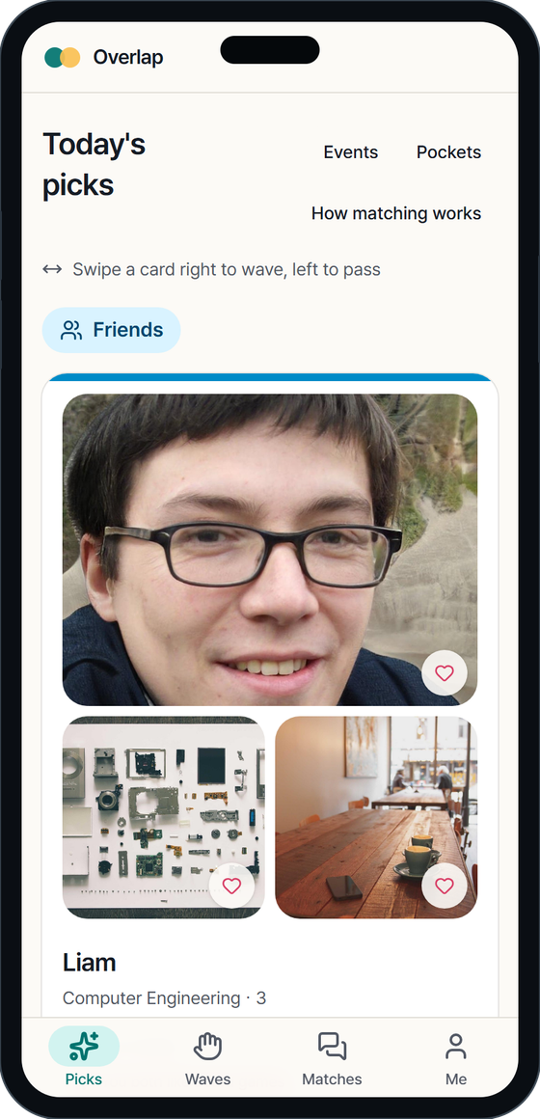
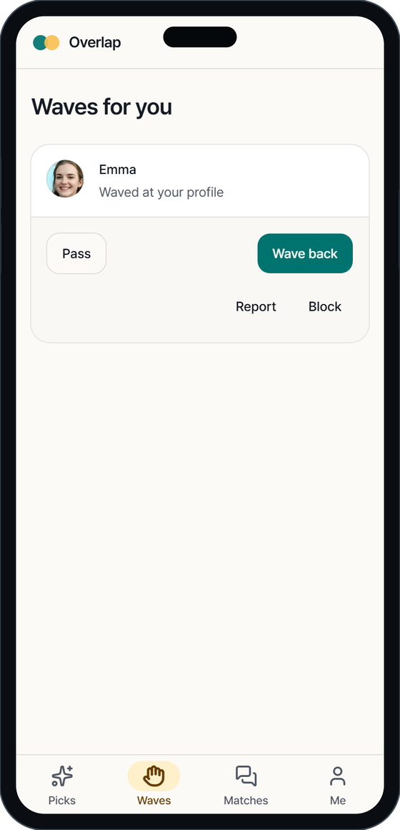
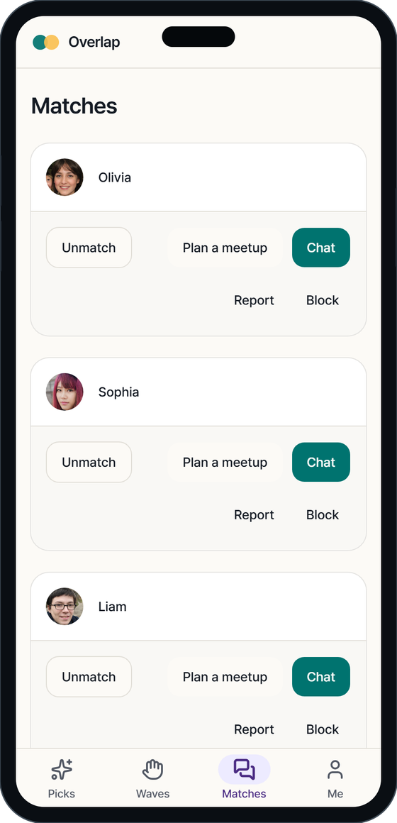
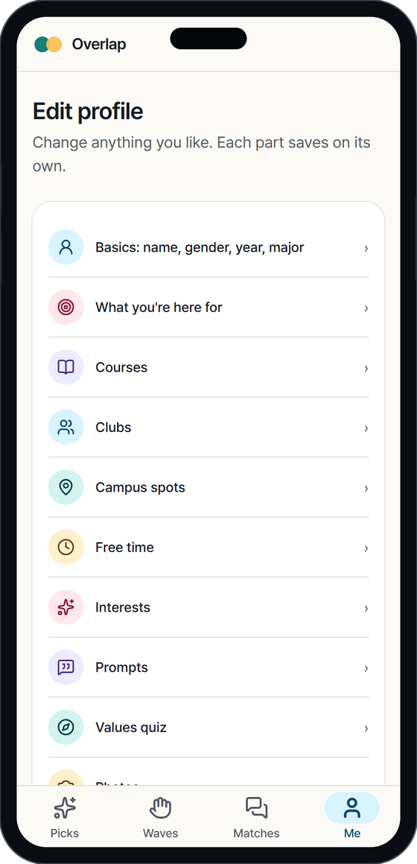
The app at a glance: four tabs
Picks
Waves
Matches
Me
Six people a day, each one explained
Who waved at you, with an optional note
Chat and plan a meetup with mutual waves
Edit your profile, privacy, data export
Notes:
[4:00-5:00] The whole app is four tabs along the bottom of the phone. Picks is your daily list of six people. Waves is where people who liked you show up, and where you can wave back. Matches is for people who waved at each other: that is where you chat and plan a meetup. Me is your profile and your settings, including privacy. The app is built mobile-first because students use it on their phones, and it works in Korean and English.

Slide 6
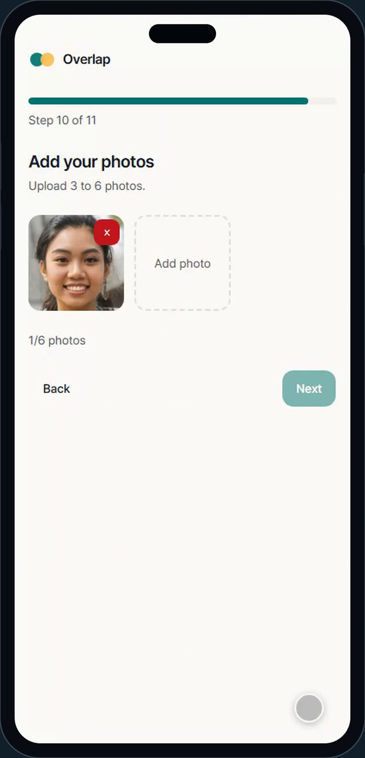
Joining takes about three minutes
1
Emailed code, no password
Sign in with a school email and a six-digit code.
2
Age check, keeps only the year
The full birth date is checked, then only the year is stored.
3
The overlap questions
Courses, clubs, free-time grid, interests, three short prompts.
4
Photos and a selfie, checked by a human
A moderator approves; the selfie is then deleted.
Screen recording of the real app · sped up 1.5×
Notes:
[5:00-7:00] Let me play the first recording. This is Dana, a brand-new student, joining for the first time. There is no password: she types her school email and gets a six-digit code. Then the age check. She enters her full birth date, the app checks she is old enough, and then it keeps only the birth year. Then the questions about what she shares with other people: her courses, her clubs, when she is free, her interests, and a few prompts. At the end she uploads photos and a selfie, and a human moderator approves the selfie. The recording is sped up one and a half times.

Slide 7
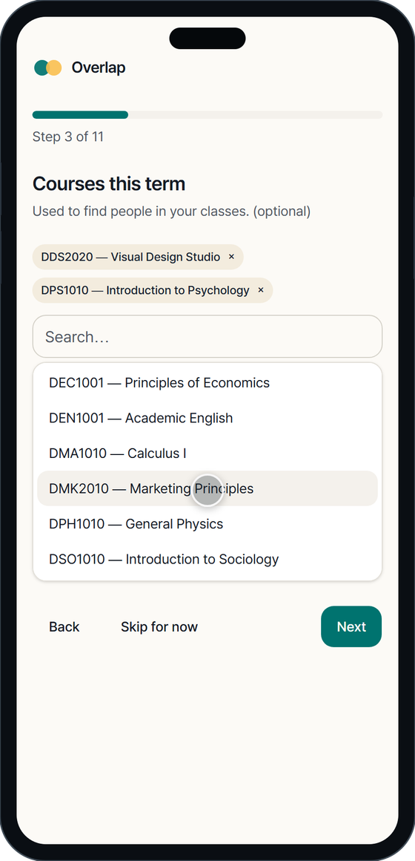
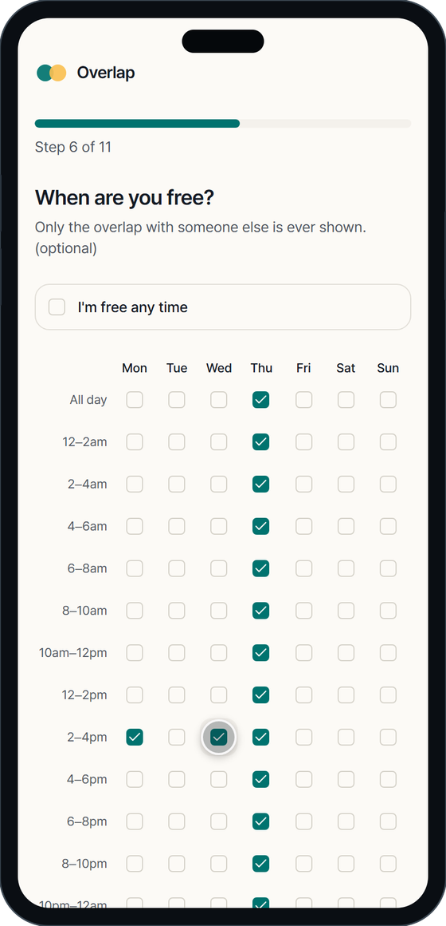
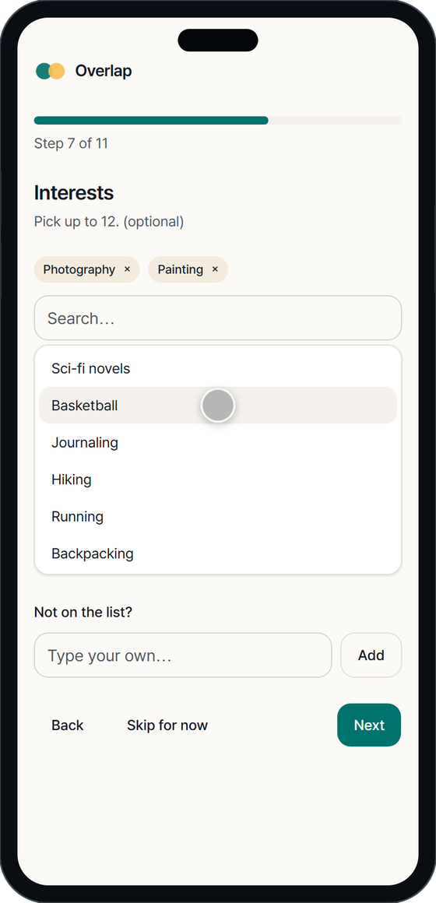
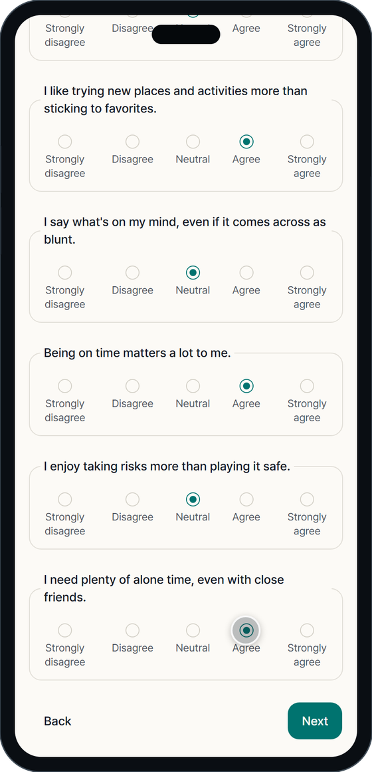
Every question feeds one part of the score
Courses
Free time
Interests
Values quiz
Same course section → term C
Same free hours → term T
Shared interests → term I
Similar answers → term V
Clubs feed term K. Nothing here asks about looks.
Notes:
[7:00-8:30] Why does the profile ask so many questions? Because each answer becomes one ingredient of the match score. Courses and clubs tell the app what you do on campus. The free-time grid, two hours at a time, finds when you could actually meet. Interests are the softer things you like. And a short values quiz, eight statements, checks whether you approach life in a similar way. Notice what is not here: nothing about looks. Each screen is optional, and you can edit any section later.

Slide 8
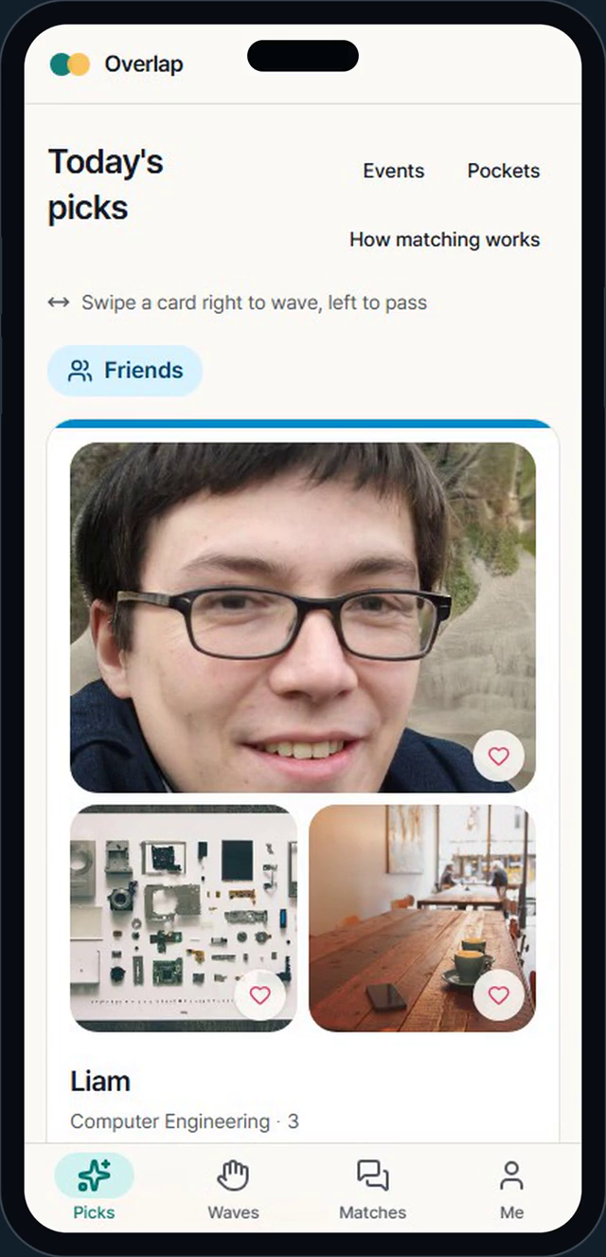
Six people a day, each one explained
1
Swipe right to wave, left to pass
Or use the buttons. A decided card folds away.
2
"Why you overlap" chips
Same section, shared club, free at the same time: every reason is shown.
3
React to a photo or prompt
A note makes a better opener than a bare like.
4
Private until mutual
A match only exists when both people wave.
Screen recording of the real app
Notes:
[8:30-10:00] Now Emma's daily picks. She gets a short list, and every card has a few chips that say why she was shown this person: same course section, same club, free at the same time. She can swipe right to wave, swipe left to pass, or use the buttons. She can also react to one specific photo or prompt, because a short note makes a better opener than a bare like. And nothing is shared until both people wave: a match only exists when it is mutual.

Slide 9
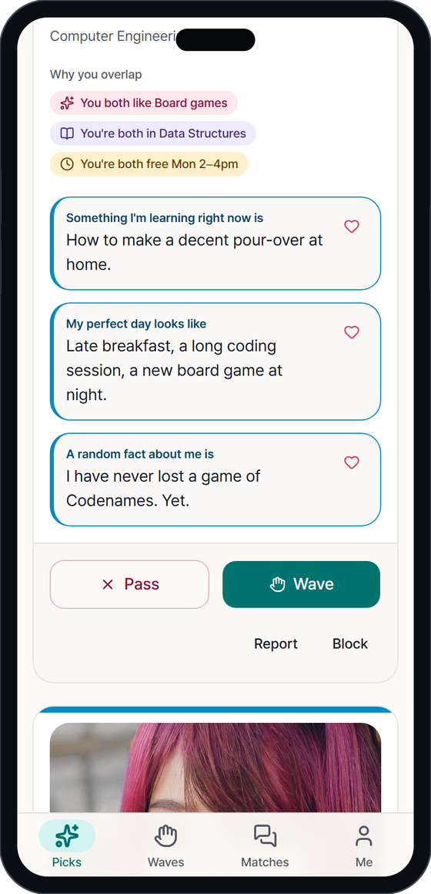
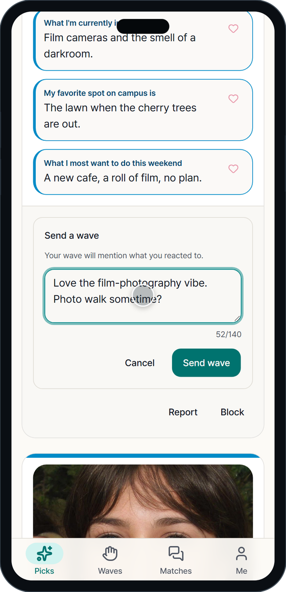
Every card says why you were introduced
Reasons are facts, not guesses
Each chip comes from something both people entered, such as a course section or a club.
React with a short note
Tap the heart on a photo or an answer and write a few words. A note makes a better opener.
A wave is private
Nothing is shared unless the other person also waves back. A note only travels with your wave.
Notes:
[10:00-11:00] Here is one card up close. The photos are on top, then the name and major, and then the part I care about most: the reasons. They are plain sentences, written only from facts both people entered: you are both in Data Structures, you are both in the board game club, you are both free Monday afternoon. If there is nothing true to say, the app does not make something up. That makes the recommendation easy to trust, and easy to explain in a class like this one.

Slide 10
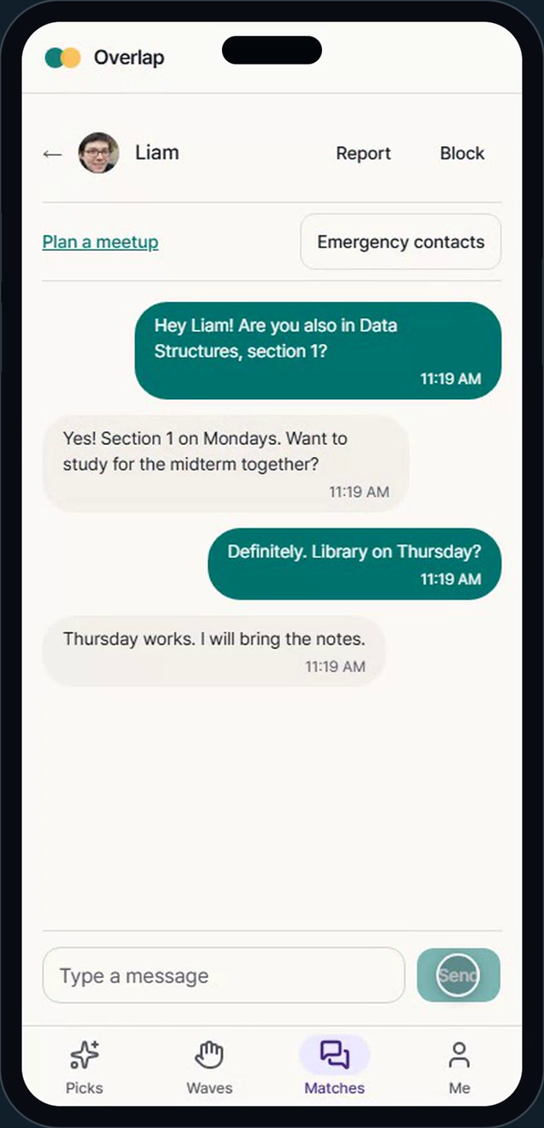
Mutual wave, match, chat
1
A match appears on mutual wave
Both people can now see each other's profile.
2
Icebreakers from what you share
Suggested openers are built from shared items only.
3
The chat stays private
It is never logged. Moderators only see what a reporter attaches.
Screen recording of the real app
Notes:
[11:00-12:00] When Emma waves at Liam and Liam waves back, they match. Both sides now see each other's full profile and a chat opens. The app suggests icebreakers, and they come from what the two of them share, for example a joke about being in the same course. The chat itself is private: the system never logs it or reads it, and moderators only see what a person chooses to attach to a report.

Slide 11
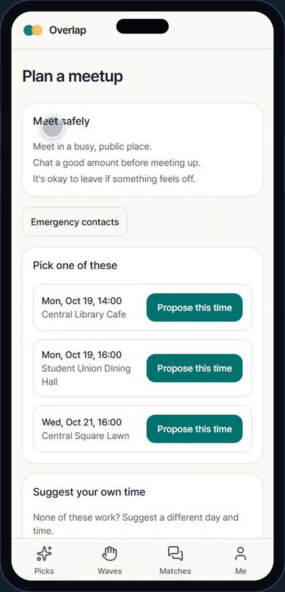
Plan the meetup from shared free time
1
Times come from your overlap
Free slots both people marked, at safe public places.
2
Yellow, green, red dots
Waiting, accepted, declined. The dot clears once it has been seen.
3
A pinned banner in the chat
A confirmed meetup stays visible, with emergency contacts.
Screen recording of the real app
Notes:
[12:00-13:00] The last step is meeting in person, which is the point of the app. From the chat you can plan a meetup. The app looks at the free slots both people marked and suggests real times at safe public places on campus. One person proposes, the other accepts or declines, and a small coloured dot shows the state: yellow is waiting, green is accepted, red is declined. Once confirmed, a pinned banner stays in the chat with emergency contacts one tap away.

Slide 12
How it chooses: five ingredients, one number
S(a,b) = 100 × ( wC·C + wK·K + wT·T + wI·I + wV·V )
C · Courses
K · Clubs
T · Free time
I · Interests
V · Values
Do you take the same course section? Sharing a section counts extra.
Do you belong to the same clubs? Rarer clubs count more.
Do your weekly free hours line up? A shared campus spot adds a little.
Do you like the same things, such as photography or board games?
How close are your answers to eight short "agree or disagree" statements?
IN PLAIN WORDS
Each ingredient answers one simple question about two people. The app blends the five answers into one score. A higher score means more in common.
Notes:
[13:00-14:30] Now the part I find most interesting: how does the app decide who to show you? Think of a recipe with five ingredients. C is courses: how much of your class schedule overlaps. K is clubs. T is free time: do your weekly free hours line up. I is interests. And V is values: how similar your answers to the eight values questions are. Each ingredient is a number between zero and one. The app mixes them with weights, multiplies by a hundred, and that gives a score out of a hundred. The weights change with the mode: for Study buddy, courses weigh the most, while for Friends, interests weigh the most.

Slide 13
Rare things count more than common things
w(x) = ln( N / (1 + n) )
N = students on campus, n = students who share it
A club of 3 people
Sharing it is a strong signal: weight 3.22.
A course of 60 people
Sharing it says much less: weight 0.49.
IN PLAIN WORDS
If everybody has it, it does not make you special. If almost nobody has it, it matters a lot.
Notes:
[14:30-15:30] One more idea makes the scores smarter. Sharing something rare says more about two people than sharing something everybody has. If only three people in a hundred join a club, and you are two of them, that is a real connection. If sixty people take the same big course, sharing it tells you much less. So every course, club and interest gets a weight: the rarer it is, the bigger the weight. The formula is the natural log of the number of students divided by one plus the number who share the thing. This is the same idea search engines use, called inverse document frequency, and the chart shows how fast the weight drops.

Slide 14
Worked example: Emma and Liam score 43.7 in Friends mode
Ingredient | Value | × Weight | = Points
Courses C | 0.55 | 0.20 | 11.0
Clubs K | 0.25 | 0.25 | 6.2
Free time T | 0.42 | 0.20 | 8.5
Interests I | 0.44 | 0.30 | 13.2
Values V | 0.97 | 0.05 | 4.8
Total |  | 1.00 | 43.7
Weights shown are Friends mode: interests 30%, clubs 25%, courses 20%, free time 20%, values 5%.
IN PLAIN WORDS
Points = how much two people overlap on an ingredient × how much that ingredient matters in this mode. Add them up and you get the score out of 100.
Notes:
[15:30-17:00] Here is a real calculation from the demo database. Emma and Liam in Friends mode. Each row is one ingredient. The value is how much they overlap, between zero and one. The weight says how much that ingredient matters in Friends mode: in this mode interests are 30 percent and clubs 25 percent. Multiply the two and you get points. The five rows add up to 43.7 out of a hundred. On the right, the same five values for the four best candidates, so you can see why Liam ranks above the others. These are the actual numbers computed by the app's own code.

Slide 15
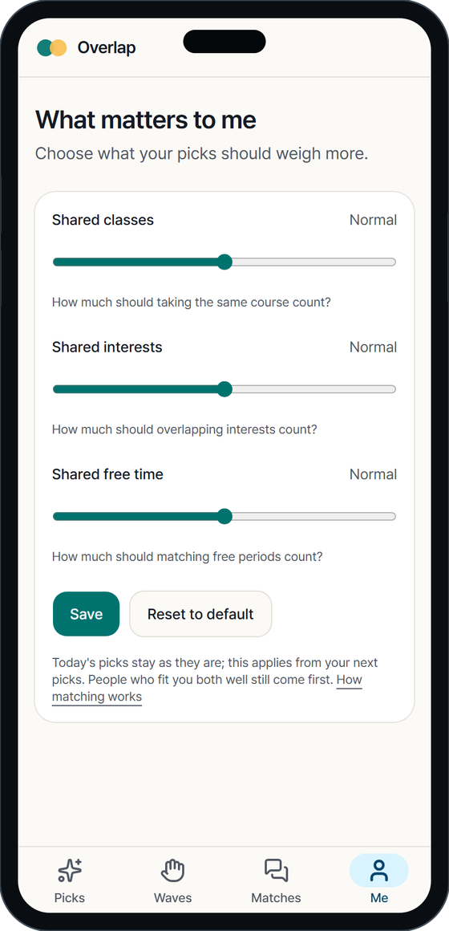
Modes change the weights, sliders make it personal
1
Three sliders
From 0.5× to 1.5× on classes, interests and free time.
2
Ranking is two-sided
Harmonic mean: good for both, not just one.
IN PLAIN WORDS
The mode says what kind of person you are looking for. The sliders let you fine-tune it. Ranking counts both people's view.
Notes:
[17:00-18:00] The same five ingredients get different weights depending on what you are looking for. In Study buddy mode, courses are 45 percent of the score and free time 30, because you want someone who is in your class and free when you are. Friends leans on interests and clubs. Dating gives values the most weight, 30 percent. Open mode simply averages the three. On top of that, each person has three sliders on the Me tab, from half to one and a half times, for classes, interests and free time, so you can say what matters to you. A second idea keeps things fair: we rank people by the harmonic mean of both directions, so the match has to be good for both people.

Slide 16
From scores to six daily picks
4
From the top
The best-ranked people on the list.
1
From the middle
Rank 20 to 50: variety, not only the obvious.
1
A newcomer
Someone who joined in the last 7 days.
Fairness rules
Nobody is shown more than 25 times a day
Passed twice means never shown again
A low trust score halves your reach
"Today" is the Seoul calendar day, not UTC
IN PLAIN WORDS
Scores make a ranked list. The list is then shaped by a few simple rules so it stays varied and fair.
Notes:
[18:00-19:00] Putting it together: the app scores everyone against Emma, ranks them, and builds today's list of six. Most of the list comes from the very top, about four people. One or two come from a middle band, rank twenty to fifty, so the app does not only show the obvious, and one place is kept for a newcomer who joined in the last week. There are fairness rules too: nobody appears more than twenty-five times a day, someone you passed on twice is never shown again, and a person with a low trust score is shown less. And 'a day' is the Seoul calendar day, not UTC, which was a real bug I had to fix.

Slide 17
The scoring is just two small functions
// How good is b for a? One number from 0 to 100
function scoreFromTerms(terms, weights) {
const raw = weights.wC * terms.C
+ weights.wK * terms.K
+ weights.wT * terms.T
+ weights.wI * terms.I
+ weights.wV * terms.V;
return 100 * clamp(raw, 0, 1);
}
// Good for BOTH people, not just one (harmonic mean)
function reciprocityScore(aToB, bToA) {
if (aToB <= 0 || bToA <= 0) return 0;
return (2 * aToB * bToA) / (aToB + bToA);
}
Why harmonic mean?
Scores of 90 and 10 average to 50 but rank only 18. A lopsided match ranks low.
Pure functions
No database, no randomness. That makes them easy to test, including tests that check score(a,b) = score(b,a).
Simplified from src/server/matching/score.ts
Notes:
[19:00-20:00] And here is how little code the heart of it is. This is simplified from the real file. scoreFromTerms multiplies each ingredient by its weight and adds them up. reciprocityScore takes the score from each person's point of view and combines them with a harmonic mean. If Emma scores Liam at 90 but Liam scores Emma at 10, the normal average is 50, but the harmonic mean is only 18, so a lopsided match ranks low. Because these are pure functions, with no database and no randomness, they are easy to test, and I wrote property-based tests that check things like: the score of A and B is the same as B and A.

Slide 18
How it is built
Browser
Next.js 16
Matching engine
Data
React 19 · Tailwind v4
Korean + English
Swipe gestures, mobile first
App Router · server actions
Every action checks
permissions itself
Plain TypeScript functions
Rarity-weighted overlap
Symmetric, property-tested
PostgreSQL + Prisma 7
Emailed codes, no passwords
Photos in object storage
→
→
→
~47,000
49
1,475
27
lines of TypeScript
database tables
unit tests
end-to-end suites
IN PLAIN WORDS
Pages in the browser call the server. The server checks who you are, asks the matching engine, and reads or writes the database. Tests run the same app on a phone and on a desktop.
Notes:
[20:00-21:30] A full-stack TypeScript app. In the browser, React 19 with Tailwind, in English and Korean. On the server, Next.js 16 with the App Router. Every change goes through a server action, and each action checks permissions itself, not only the routing layer. The matching engine is plain TypeScript functions. The data sits in PostgreSQL through Prisma, with 49 tables and 26 migrations. For testing I use Vitest for unit and property tests, Playwright for end-to-end tests on phone and desktop, and axe for accessibility. In total, about 47,000 lines of TypeScript across the website and the mobile app, 1,475 unit tests, and 27 end-to-end suites. One thing is new since the first version: there is also a native Android and iPhone app, written with Expo and React Native, that talks to the same server through a small mobile API, so the matching and safety rules are the same code. It is still being tested.

Slide 19
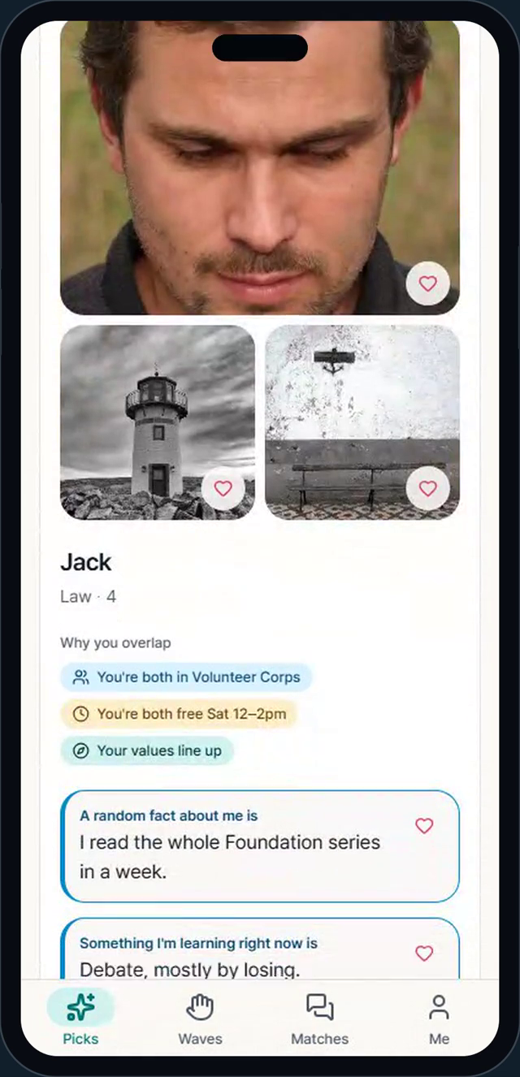
Safety: report, human decision, enforcement
1
A person reports
Pick a reason, add context. Urgent kinds are sorted first.
2
A moderator decides
A human reads it and writes a reason. Never automatic.
3
Enforcement is clear
Warn, 7-day suspension, ban. The person sees why and can appeal.
Screen recording of the real app
Notes:
[21:30-23:00] A dating app has to take safety seriously, so here is the report flow. Olivia reports Jack for harassment. The report goes to a moderator queue, and urgent categories such as non-consensual images are sorted first. A human moderator reads it and decides, always with a written reason: dismiss, warn, suspend for seven days, or ban. The system never punishes automatically. Jack then sees a banner explaining the suspension and how long it lasts, and he can appeal. Everyone can also block someone, or hide from them, in two taps.

Slide 20
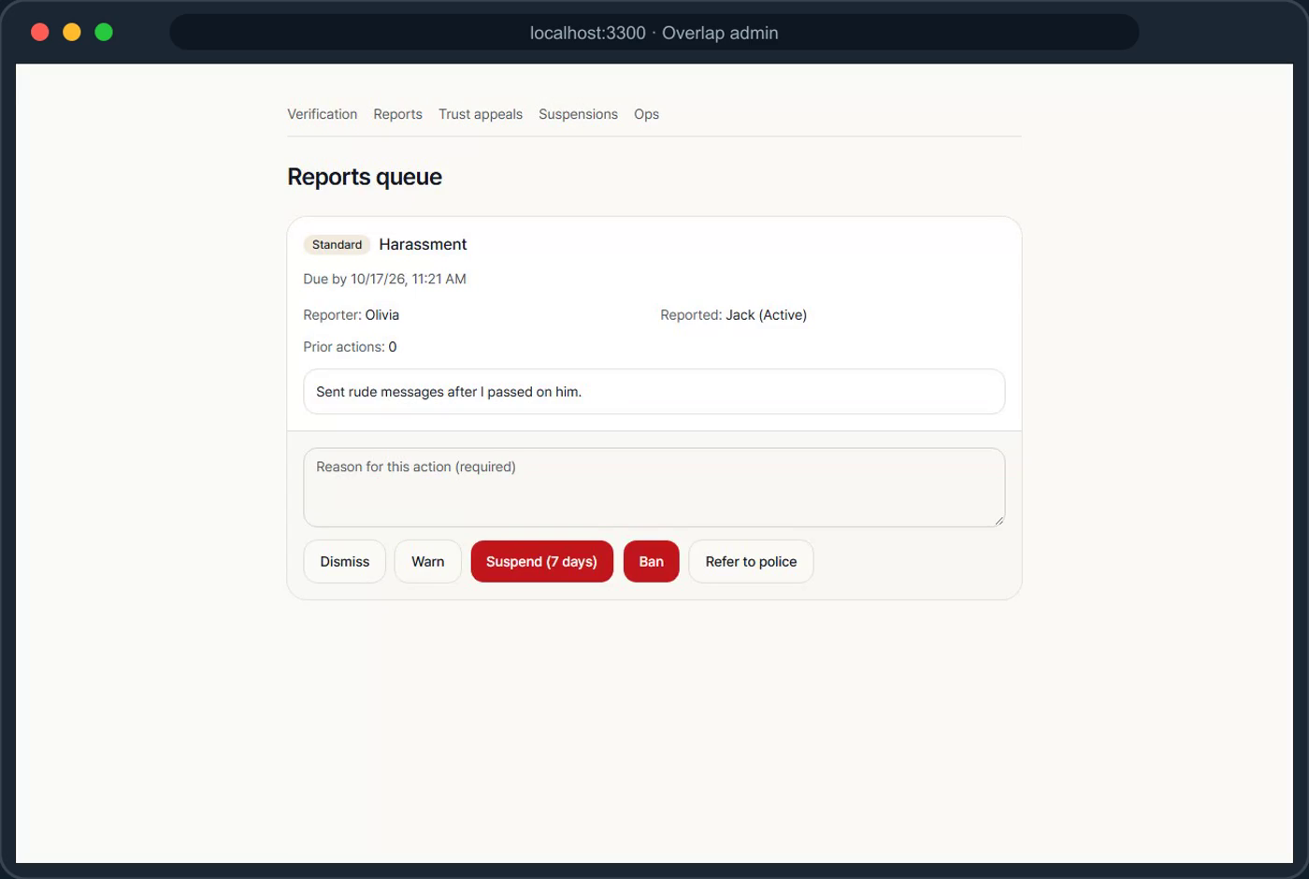
What the moderator sees
1
Verification queue
Compare a selfie to the profile photos, then approve or reject.
2
Reports queue
Urgent first. Every decision needs a written reason.
3
Moderators see the minimum
Who someone wants to date is never loaded for them.
Screen recording of the real admin tools
Notes:
[23:00-24:00] This is the moderator's side, on desktop. The first screen is the selfie verification queue: the moderator compares a new person's selfie to their profile photos and approves it. Then the reports queue, with the oldest and most urgent first. Notice something important: moderators see what they need and no more. They cannot see who someone is interested in dating, because that field is never even requested from the database for their role. I tested that at the query level, not just on the screen. There is also a small operations page with funnel numbers and the response-time target for reports.

Slide 21
Privacy rules built into the code
No ID numbers
Selfies are temporary
Chats stay private
Only the birth year is kept after the age check.
Deleted within 7 days. Only a "verified" flag stays.
Never logged or shared. Moderators see only what a reporter attaches.
Encrypted preferences
Delete means delete
Fictional data only here
Who you'd like to date is encrypted and never shown to moderators.
30-day grace period, then your identity is scrubbed.
Fake users exist only on a development database, never in production.
IN PLAIN WORDS
The safest data is data you never collect. For what the app does keep, the code, not just a policy, decides who can read it.
Notes:
[24:00-25:00] Privacy is not a paragraph in a policy here, it is enforced in code. We never store identity numbers: only the birth year is kept after the age check. Selfies are deleted within seven days; only a verified flag stays. Chats are never logged or shared. The field that says who you would like to date is encrypted in the database and never shown to moderators. If you delete your account, there is a thirty-day grace period and then your identity is scrubbed. And fake users like the ones in today's demo can only exist on a development database, never in production.

Slide 22
Where it stands and what comes next
Now
Before launch
First pilot
Later
Live at overlaps.tech, no invites yet; mobile app in progress
A written moderator on-call rota; a 300+ waitlist or a pilot of 50 or fewer
Invite-only, at most 50 people, one campus
More campuses, Android and iPhone apps, chat photos
Still open (three are accepted risks)
IN PLAIN WORDS
A lawyer's review of the Terms and the Privacy Policy
A named privacy officer and the official filings
Today the age check is a birth year plus a declaration; an agency check is planned
Two moderators signed up; written on-call rota still to do
Overlap is working and live, but invite-only and not yet a public service. The next steps are about trust and safety, not new features.
Notes:
[25:00-26:00] So where is Overlap today? It works end to end, and the landing page is live at overlaps.tech. I have tested it with a small team, no real students have been invited yet, and it is not open to the public. Before that I still have to write the moderator on-call rota, and either collect a waitlist of about three hundred people or start with a small pilot of fifty or fewer. Three things are still open, and I have accepted them as launch risks: a lawyer's review of the Terms and Privacy Policy, a named privacy officer with the official filings, and, for dating, an age check that is a birth year plus a declaration, with a proper verification agency planned. Events, campus pockets, web push notifications and the trust score are already built, and I am now building a native Android and iPhone app. What comes next is more campuses, chat photos with automatic screening, and the mobile apps.

Slide 23
What I learned building it
1
2
3
Small pure functions
Never select it, don't just hide it
Test the real path, phone and desktop
Keep the scoring logic free of the database. Property tests (for example, score(a,b) = score(b,a)) caught a real bug with duplicate items.
A field a role must not see should never be loaded for that role. Tests check the database query, not only the screen.
A button can look ready before the page has finished loading. Browser tests on both sizes found bugs unit tests could not.
Notes:
[26:00-27:30] Three lessons. One: keep the interesting logic in small pure functions. The scoring is easy to reason about and to test, and property tests found a real bug where swapping two users changed the score, because of duplicate items in a list. Two: privacy is stronger when a field is never selected from the database than when a screen just hides it. I test that at the query level. Three: test the real user path on both phone and desktop. Many bugs only appeared there, for example a button that looked ready but had not finished loading, so a quick click was silently dropped.

Slide 24
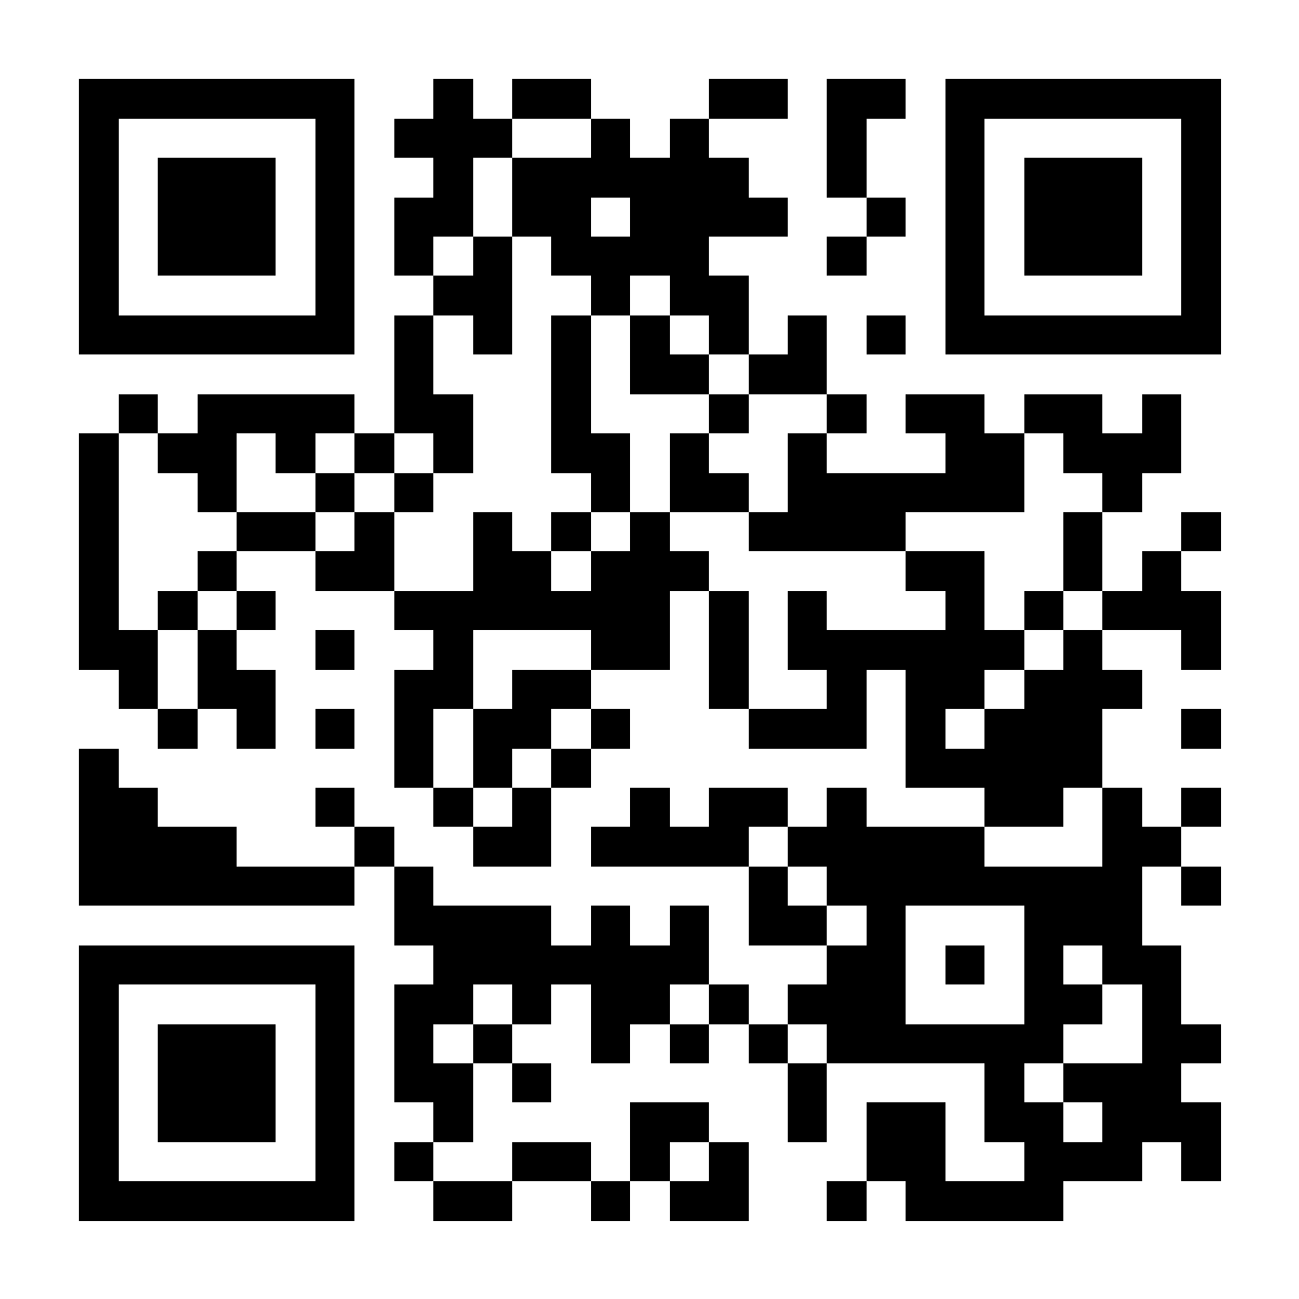
Scan to visit Overlap
Point your phone camera here
overlaps.tech
https://overlaps.tech
1
Open the page
Scan the code, or type the address.
2
Join the waitlist
Leave your email and we will write when we open.
Notes:
[27:00-27:30] Before questions: please scan this with your phone camera to open the Overlap landing page and join the waitlist. The address is overlaps.tech. It is the real, live landing page; the students and photos you saw in the demo are fictional, but the page is the real project.

Slide 25
Questions?
All people, photos and data shown are fictional · Overlap is not open to the public
Portraits: AI-generated faces (this-person-does-not-exist.com). Scene photos: Lorem Picsum / Unsplash.
Notes:
[27:30-] Thank you. I am happy to take questions, and I can also run any part of the app live, since it is running on this laptop. The cheat-sheet in the backup slides lists the demo accounts and the commands.

Slide 26
Backup
Screens, tools and the live-demo cheat-sheet
Notes:
Backup slides: not part of the talk, kept here in case of questions.

Slide 27
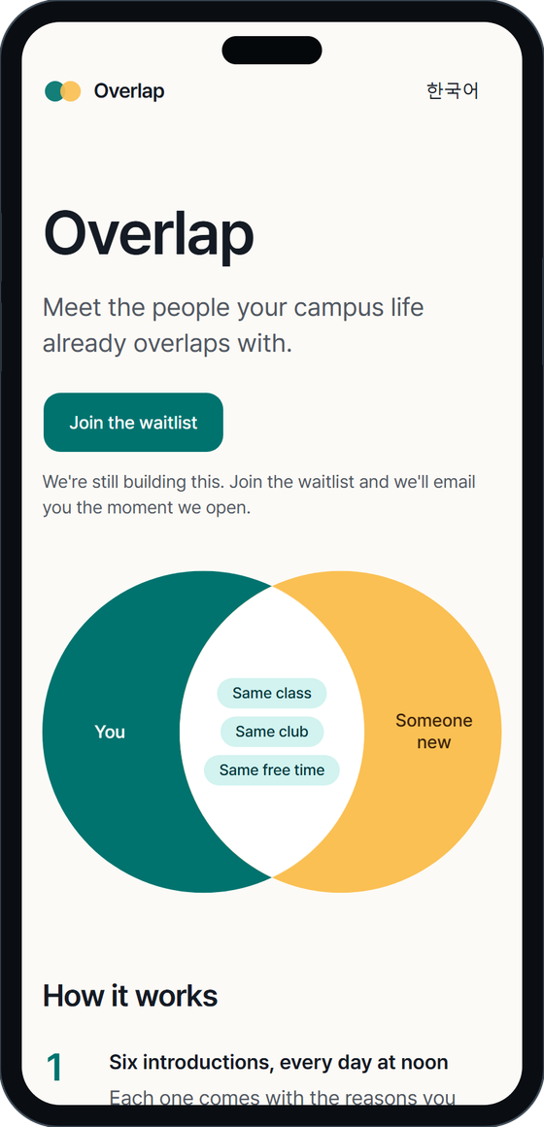
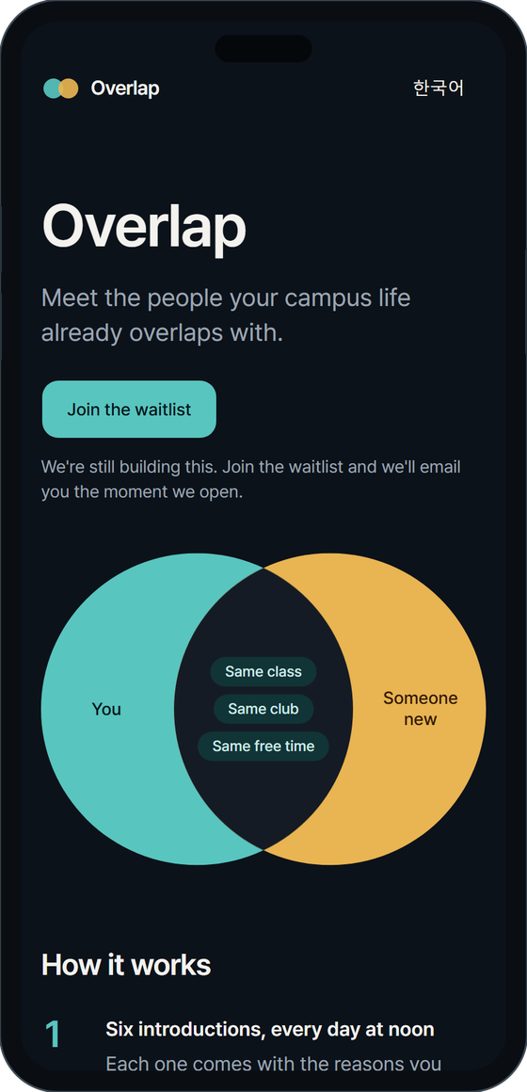
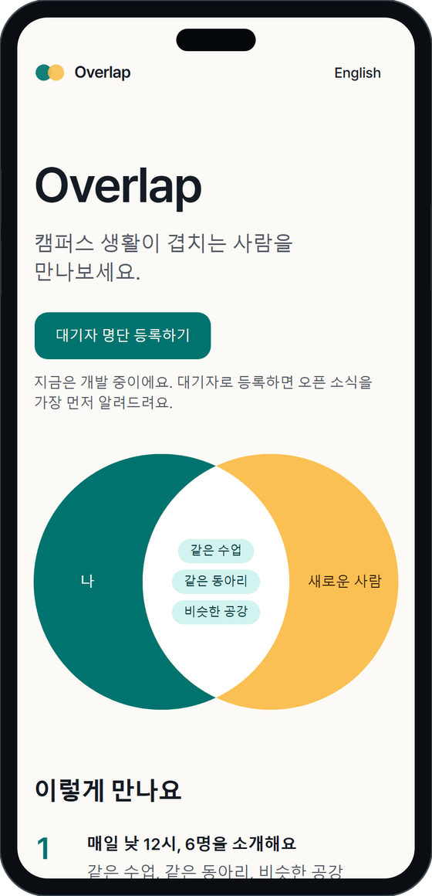
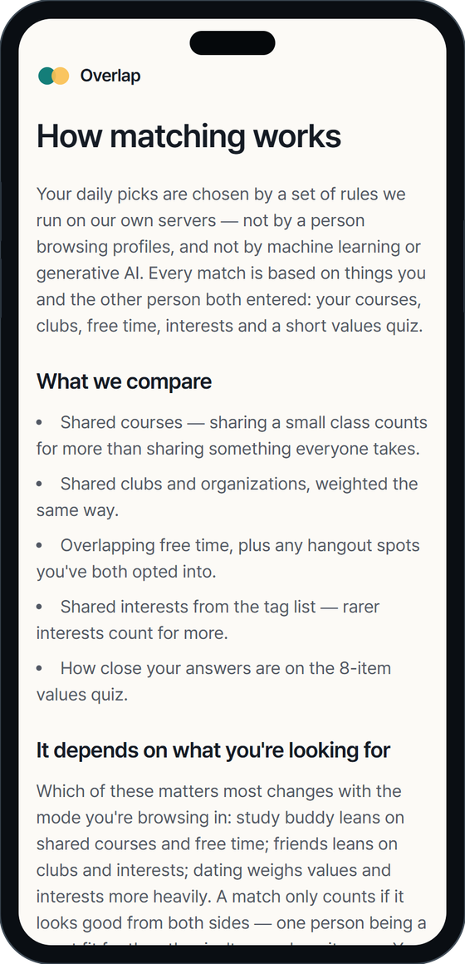
Backup: landing page, dark mode, Korean and sign-up
Landing
Dark mode
Korean
How matching works
Notes:
Backup. The landing page in light and dark mode, in Korean, and the age and consent step with the explanation of how matching works.

Slide 28
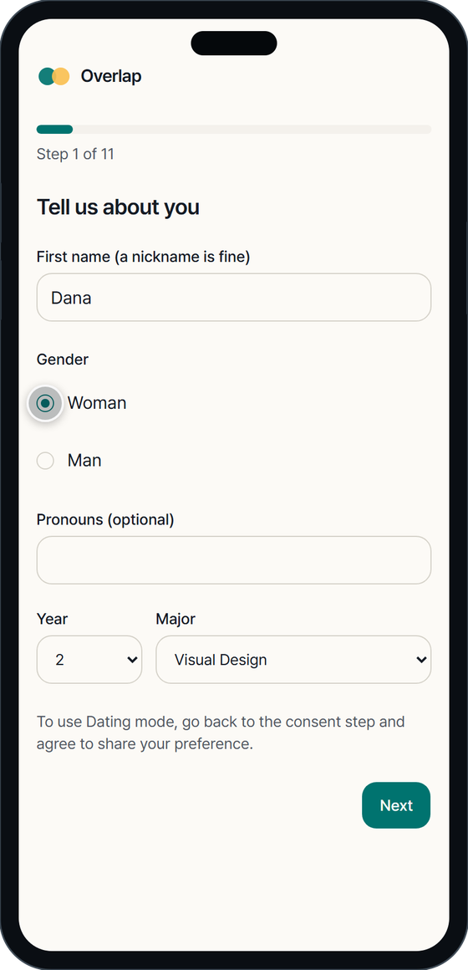
Backup: the profile wizard
Basics
Courses
Free time
Values quiz
Notes:
Backup. The first screens of the profile wizard: basics, courses, free time and the values quiz.

Slide 29
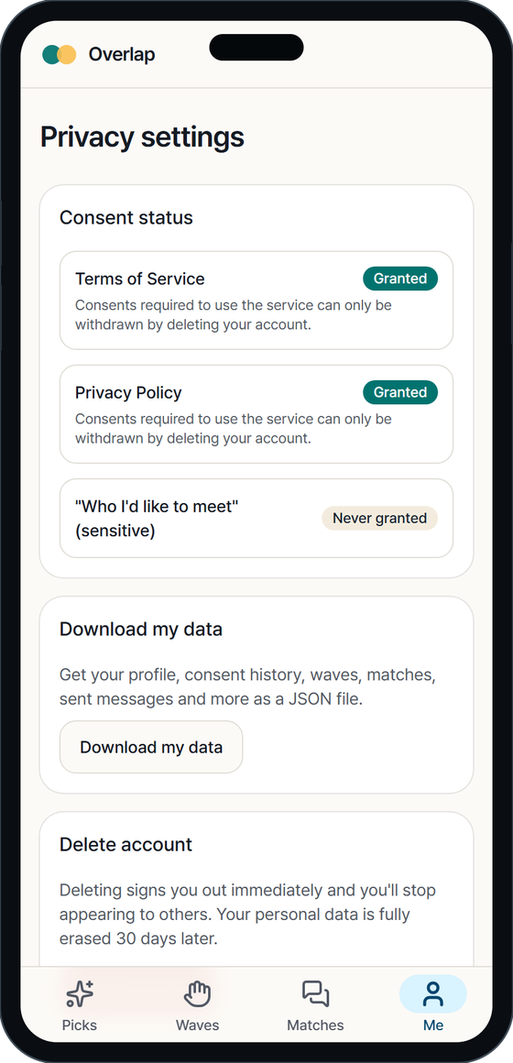
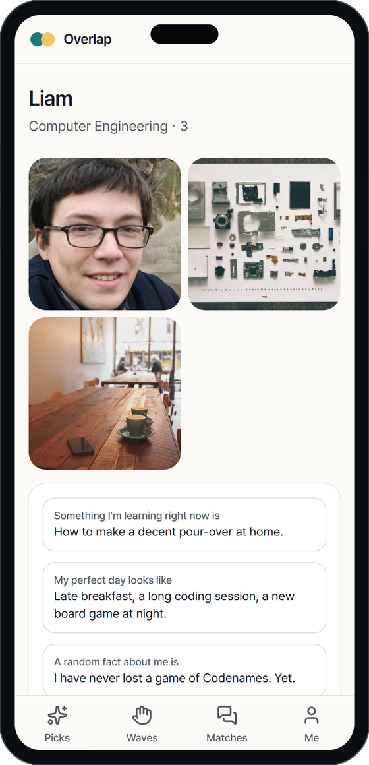
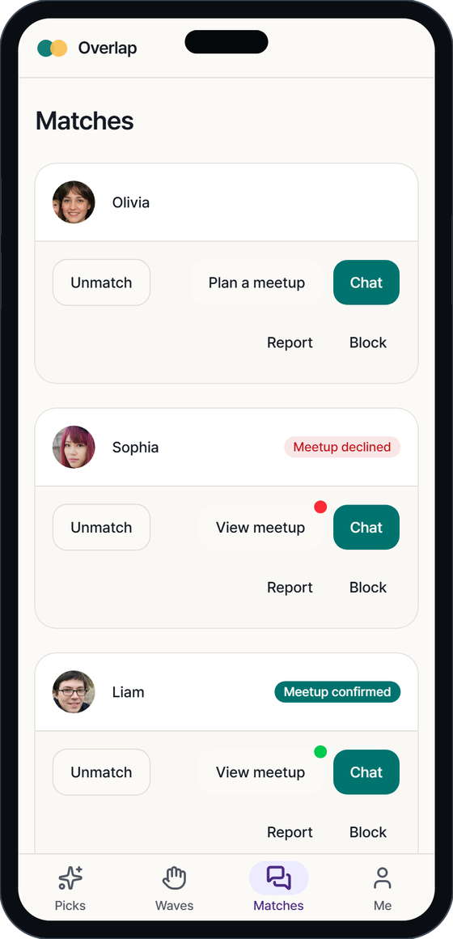
Backup: settings, profiles and meetup states
Edit any section
Privacy and export
A matched profile
Meetup dots
Notes:
Backup. Edit any section of your profile, the privacy page with consent history and data export, a matched profile, and the matches list with the meetup state dots.

Slide 30
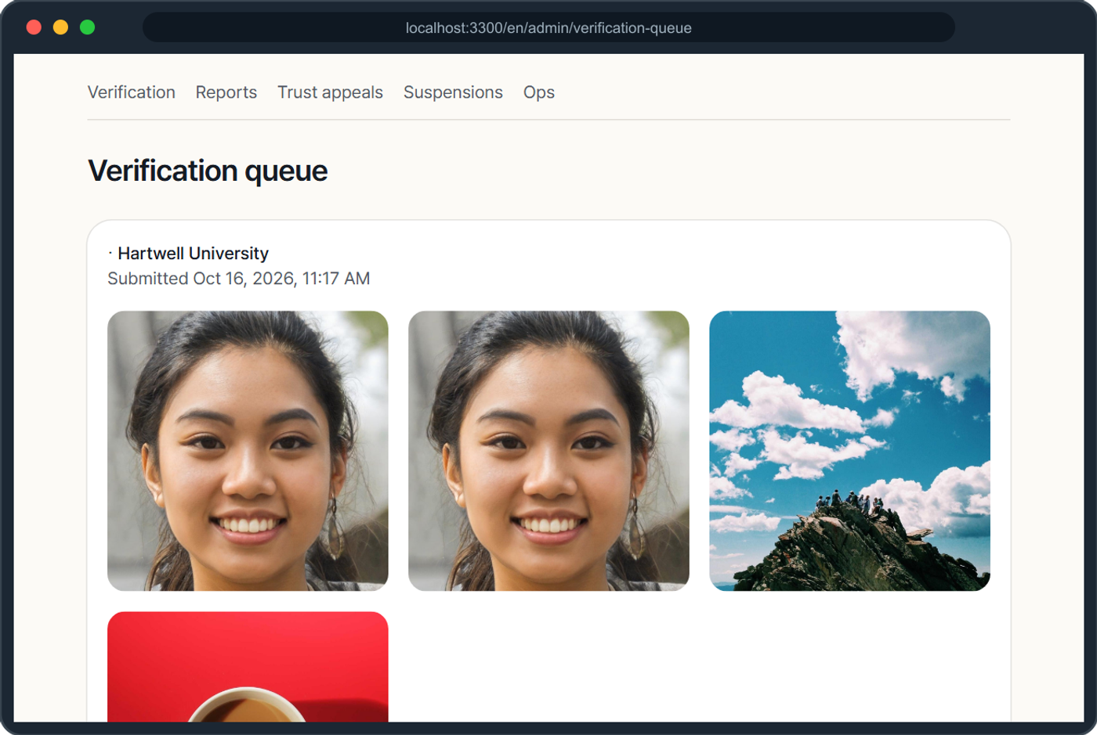
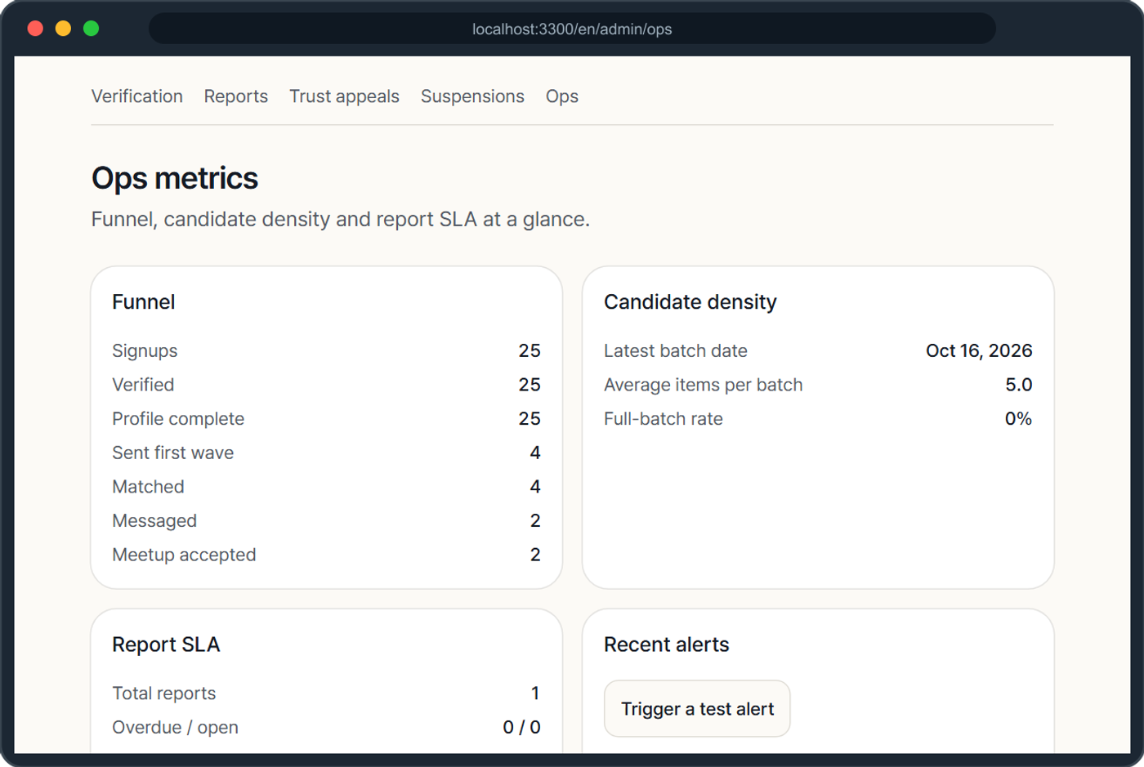
Backup: moderator and operations tools
Selfie verification queue
Operations metrics
Notes:
Backup. The selfie verification queue and the operations metrics page.

Slide 31
Backup: live-demo cheat-sheet
# 1. database (leave running)
node pg.mjs start
# 2. rebuild the fake campus, then start the app
./rebuild-demo.sh
# 3. open http://localhost:3300/
# sign in with emma@hartwell.edu
# the 6-digit code is in the app's .dev-outbox.jsonl
Demo accounts
emma, liam, sophia, daniel, olivia, noah, ethan, grace, jack @hartwell.edu. The operator account is the moderator.
Rules of the demo
Local database only. No real email is sent. Never point this at the production database.
Notes:
Backup. How to start the local demo again, and who to sign in as. Sign-in codes appear in a local file because no real email is sent.

